Slide 1
Efficient Transformer Inference for Text Classification
90.48%
FP32 validation accuracy
789 / 872 correct
1.83×
INT8 batch-8 latency speedup
435.28 → 238.40 ms
DistilBERT · SST-2 · Dynamic Quantization · torch.compile
48.2%
model size reduction
255.45 → 132.29 MB
Team: Abinesh · Akshith · Arushi | CSCI 611
CSCI 611 · Efficient Transformer Inference · Full SST-2 Final Results
1

Slide 2
Problem: accurate models also need efficient inference
In production, model quality is only one part of deployment readiness.
Transformer models can achieve strong accuracy but still be expensive during inference.
Production systems care about latency, throughput, memory footprint, and model size.
Optimization can change numerical behavior, so accuracy must be measured after optimization.
1. Train baseline
Fine-tune DistilBERT on SST-2 and record FP32 quality.
2. Optimize
Apply dynamic quantization and torch.compile to the same checkpoint.
3. Benchmark
Measure accuracy, latency, throughput, size, memory, and compile overhead.
quality
Accuracy
speed
Latency
memory
Model size
scale
Throughput
CSCI 611 · Efficient Transformer Inference · Full SST-2 Final Results
2

Slide 3
Dataset and task: SST-2 sentiment classification
Binary text classification using a full SST-2 fine-tuning run.
67,349
training examples
full train split
872
validation examples
labeled eval split
0 / 1
labels
negative / positive
A100
training hardware
full run
Raw sentence | Label
“I really enjoyed the film.” | positive (1)
“The acting was boring and weak.” | negative (0)
“This movie was excellent and emotional.” | positive (1)
Why tokenization is needed
DistilBERT cannot consume raw strings. The tokenizer converts sentences into input_ids, and attention_mask marks real tokens versus padding.
Correct reporting
We report validation accuracy, not test accuracy. The 872-example SST-2 validation split is the labeled evaluation set used for local scoring.
CSCI 611 · Efficient Transformer Inference · Full SST-2 Final Results
3

Slide 4
Inference pipeline: text becomes tensors, tensors become logits
The same input/output pipeline is used by FP32, quantized, and compiled variants.
Raw text
“This movie was excellent”
Tokenizer
WordPiece vocabulary
Model inputs
input_ids + attention_mask
DistilBERT
encoder + classifier head
Logits
[neg_score, pos_score]
Prediction
argmax(logits)
Tensor shapes
input_ids: [B, L] attention_mask: [B, L] labels: [B]
Prediction rule
argmax(logits) chooses the larger class score. Logits are raw class scores, not probabilities.
CSCI 611 · Efficient Transformer Inference · Full SST-2 Final Results
4

Slide 5
FP32 baseline: reference model
The optimized variants are compared against the same full-SST-2 trained checkpoint.
Training setup
Base model: distilbert-base-uncased Train split: 67,349 examples Validation split: 872 examples Epochs: 1 · Seed: 42 Training hardware: A100 GPU Evaluation metric: validation accuracy
90.48%
FP32 validation accuracy
789 / 872 correct
435.28 ms
local CPU batch-8 latency
18.38sentences/s
batch-8 throughput
255.45 MB
FP32 model size
Baseline definition
The baseline is the original fine-tuned FP32 DistilBERT model before compression or compiled execution. It is the reference for quality, latency, throughput, memory, and model size.
CSCI 611 · Efficient Transformer Inference · Full SST-2 Final Results
5

Slide 6
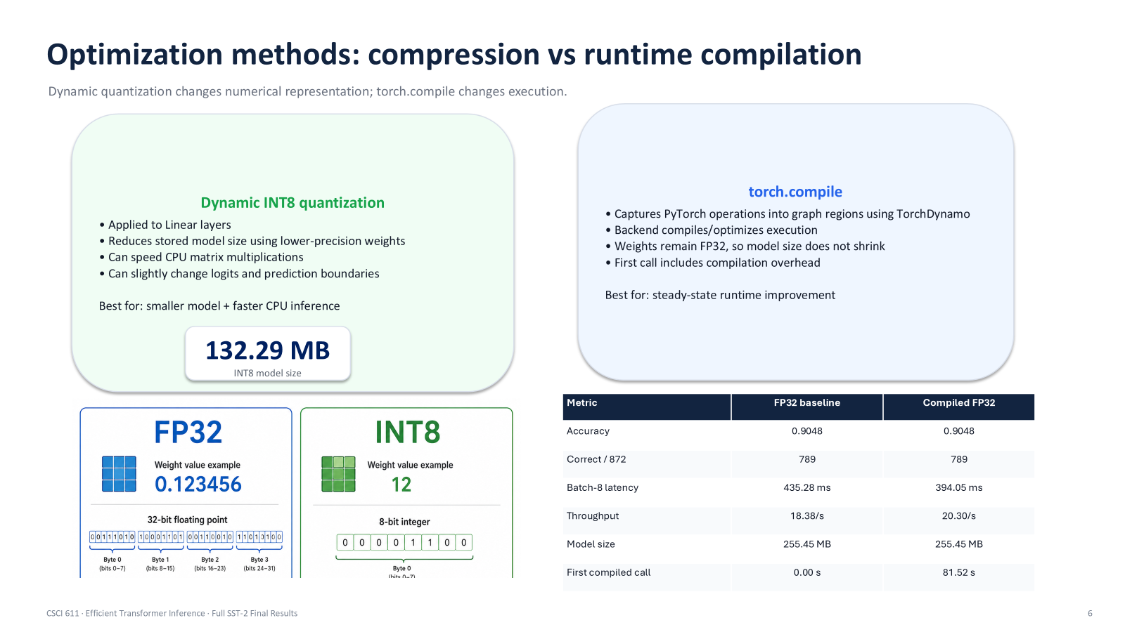
Optimization methods: compression vs runtime compilation
Dynamic quantization changes numerical representation; torch.compile changes execution.
Dynamic INT8 quantization
• Applied to Linear layers • Reduces stored model size using lower-precision weights • Can speed CPU matrix multiplications • Can slightly change logits and prediction boundaries Best for: smaller model + faster CPU inference
torch.compile
• Captures PyTorch operations into graph regions using TorchDynamo • Backend compiles/optimizes execution • Weights remain FP32, so model size does not shrink • First call includes compilation overhead Best for: steady-state runtime improvement
CSCI 611 · Efficient Transformer Inference · Full SST-2 Final Results
6

Slide 7
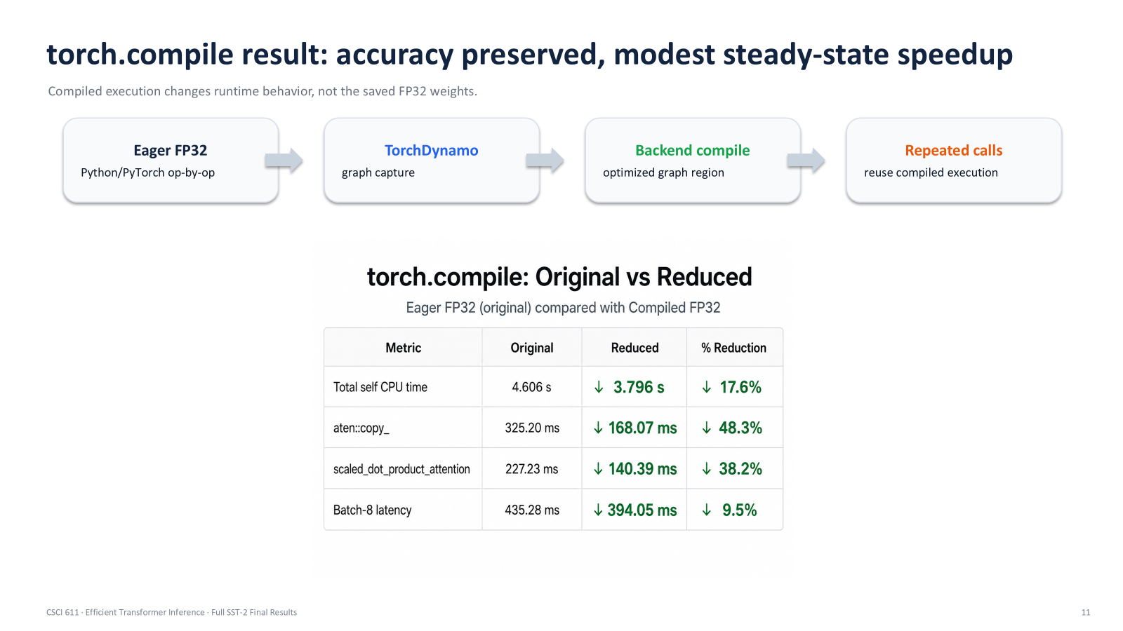
torch.compile result: accuracy preserved, modest steady-state speedup
Compiled execution changes runtime behavior, not the saved FP32 weights.
Eager FP32
Python/PyTorch op-by-op
TorchDynamo
graph capture
Backend compile
optimized graph region
Repeated calls
reuse compiled execution
Metric | FP32 baseline | Compiled FP32
Accuracy | 0.9048 | 0.9048
Correct / 872 | 789 | 789
Batch-8 latency | 435.28 ms | 394.05 ms
Throughput | 18.38/s | 20.30/s
Model size | 255.45 MB | 255.45 MB
First compiled call | 0.00 s | 81.52 s
Interpretation
torch.compile preserved model quality and improved steady-state latency by about 1.10×. However, the first compiled call took 81.52 seconds, so compile overhead matters for short-running workloads.
CSCI 611 · Efficient Transformer Inference · Full SST-2 Final Results
11

Slide 8
Benchmark methodology and environment
Fair comparison requires separating training hardware from inference benchmarking.
Training
Full SST-2 fine-tuning was done on the university A100 GPU. This made full-dataset training fast and proposal-aligned.
Inference comparison
Batch-8 CPU inference comparison was run locally after transferring the full checkpoint. CPU benchmarking is relevant because PyTorch dynamic quantization targets CPU inference.
model.eval()
disable training behavior
Avoid dropout - turn off activations to reduce overfitting during training
no_grad()
avoid gradient tracking
Because no training, we are doing inference which uses less memory
warmup
avoid startup noise
measured runs
latency + throughput
same validation split
872 labeled examples
Metrics
Accuracy · Correct count · Latency · Throughput · Model size · Memory · Compile first-call overhead
CSCI 611 · Efficient Transformer Inference · Full SST-2 Final Results
7

Slide 9
Main batch-8 result: full-SST-2 trained checkpoint
Dynamic quantization gives the strongest size and latency improvement; torch.compile preserves accuracy but has high first-call overhead.
Variant | Accuracy | Correct / 872 | Latency | Speedup | Throughput | Model Size | Compile First Call
FP32 baseline | 0.9048 | 789 | 435.28 ms | 1.00× | 18.38/s | 255.45 MB | 0.00 s
Dynamic INT8 | 0.8968 | 782 | 238.40 ms | 1.83× | 33.56/s | 132.29 MB | 0.00 s
Compiled FP32 | 0.9048 | 789 | 394.05 ms | 1.10× | 20.30/s | 255.45 MB | 81.52 s
1.83×
INT8 latency speedup
435.28 → 238.40 ms
48.2%
INT8 size reduction
255.45 → 132.29 MB
0.80 pp
INT8 accuracy drop
90.48% → 89.68%
81.52 s
compile first call
batch-8
Careful interpretation
Quantization improved size and latency, but it did not preserve exact accuracy. torch.compile preserved accuracy and slightly improved steady-state latency, but first-call compilation overhead was large.
CSCI 611 · Efficient Transformer Inference · Full SST-2 Final Results
8

Slide 10
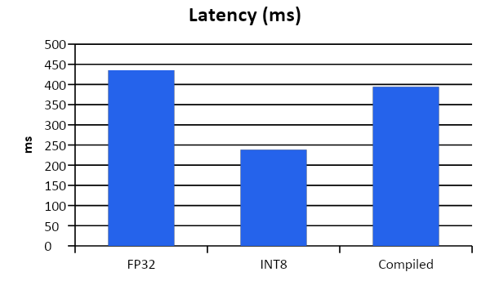
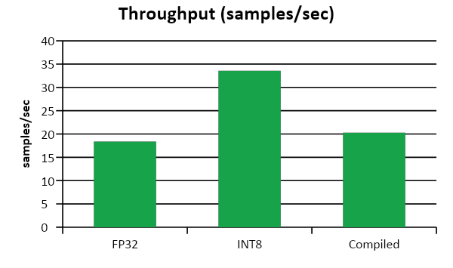
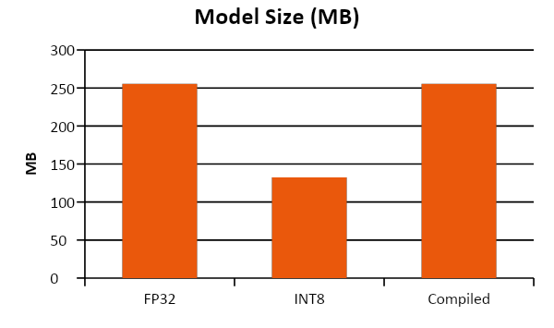
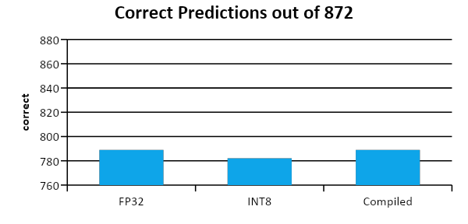
Visual comparison at batch size 8
Lower latency and smaller size are better; higher throughput is better.
Reading the charts
INT8 is the smallest and fastest in the local CPU batch-8 run. Compiled FP32 preserves FP32 accuracy but gives a smaller latency gain and has high startup compile cost.
CSCI 611 · Efficient Transformer Inference · Full SST-2 Final Results
9

Slide 11
Quantization diagnostic: smaller and faster, but not prediction-identical
Prediction-level checks prevent misleading accuracy claims.
Dynamic quantization changes numerical representation in Linear layers. That can slightly shift logits and flip some low-margin predictions.
Diagnostic run
A full-model diagnostic run at batch size 8 showed 38 changed predictions: 21 FP32-correct examples became wrong and 17 FP32-wrong examples became correct.
38
changed predictions
out of 872
21
correct → wrong
harmful flips
17
wrong → correct
helpful flips
low margin
flipped examples
near decision boundary
Conclusion
The INT8 model should be reported as a size/latency optimization with a small accuracy tradeoff, not as a model-quality improvement.
CSCI 611 · Efficient Transformer Inference · Full SST-2 Final Results
10

Slide 12
Conclusion: dynamic quantization was the strongest practical optimization
Final results are based on full SST-2 training and batch-8 CPU inference comparison.
Best size + latency
Dynamic quantization reduced model size by 48.2% and improved batch-8 latency by 1.83×.
Quality tradeoff
INT8 accuracy dropped from 90.48% to 89.68% in the local batch-8 run, a small but real tradeoff.
Compile tradeoff
torch.compile preserved accuracy and slightly improved latency, but first-call compile overhead was high.
Final takeaway
Inference optimization cannot be judged by one metric. We measured accuracy, correct count, latency, throughput, model size, and compile overhead. Dynamic quantization gave the best deployment-style size/latency improvement, while diagnostics showed why optimized models must still be validated carefully.
CSCI 611 · Efficient Transformer Inference · Full SST-2 Final Results
12

